Slide 1
Testing backend integration points
What is Backend Testing and How to perform it?
Most system testing efforts go through GUI. This is because testing validates if the software is ‘fit for use’ by the end-user or not.
But, software has a lot of other elements too that aren’t directly visible or available to the user for direct interaction. It does not make these elements any less important and they must too undergo thorough testing.
The combination of all these well-functioning elements makes a fully formed software application. We can combine everything we do not directly see as ‘Back-end’.
The backend testing ensures that your application works fine at the server-side and it assures the quality of the database.
Some of the Backend Testing elements are:
Database
APIs
Servers

Slide 2
Database Testing?
Database Testing is a type of software testing that checks the schema(the skeleton structure that represents the logical view of the entire database.), tables, triggers(a trigger can be invoked when a row is inserted into a specified table or when certain table columns are being updated.), etc. of the Database under test.
It also checks data integrity(accuracy ) and consistency. It may involve creating complex queries to load/stress test the Database and check its responsiveness.
Database Testing is Important in software testing because it ensures data values and information received and stored into database are valid or not.
Database testing helps to save data loss, saves aborted transaction data and no unauthorized access to the information.

Slide 3
Let us consider a Banking application wherein a user makes transactions. Now from Database Testing or DB Testing viewpoint following, things are important:
The application stores the transaction information in the application database and displays them correctly to the user.
No information is lost in the process.
No unauthorized individual is allowed to access the user’s information.
To ensure all these above objectives, we need to use data validation or data testing.

Slide 4
API testing
API stands for Application Program Interface and this is basically where all the programming logic resides. It does not have a UI which is one of the biggest challenges when it comes to testing it.
The purpose of API Testing is to check the functionality, reliability, performance, and security of the programming interfaces.
In API Testing, instead of using standard user inputs(keyboard) and outputs, you use software to send calls to the API, get output, and note down the system’s response.
API tests are very different from GUI Tests and won’t concentrate on the look and feel of an application. It mainly concentrates on the business logic layer of the software architecture.

Slide 5
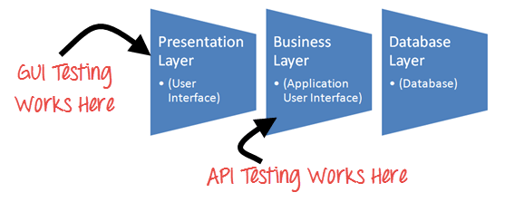

Slide 6
What is Server Testing:
Server testing typically involves running a series of script-based tests on the server tests where the app or site is stored.
Server testing allows your development team to identify and fix flaws like downtime or run-time errors, for example.
Here are three good reasons to perform server tests:
Find bugs: You can find bugs and other errors that might affect the app or website performance. Thanks to server testing, you can determine whether any new feature will affect how a project works.

Slide 7
Determine concurrent usage: When you conduct the tests, you will understand the maximum number of concurrent users a site or an app can handle at any given time.
You will also have a good idea of the amount of bandwidth, storage, or processing capacity you need to acquire if your targets' current capacity falls short.
Improve website or app performance: Server testing can help you reduce the time required to request code and database optimization.
You can reduce the occurrence of memory leaks(Memory leak occurs when programmers create a memory in heap and forget to delete it. ) and system crashes.

Slide 8
REPL-driven development Repl :
The term “REPL” is an acronym for Read, Evaluate, Print and Loop because that’s precisely what the computer does..!
REPL (READ, EVAL, PRINT, LOOP) is a computer environment similar to Shell (Unix/Linux) and command prompt.
A Read-Eval-Print Loop, or REPL, is a computer environment where user inputs are read and evaluated, and then the results are returned to the user.
The REPL is an instant feedback workflow that continually runs your code without the need to manually run an explicit compile-build-run cycle.

Slide 9
To make this work, the computer does four things:
Read the user input (your Python commands).
Evaluate your code (to work out what you mean).
Print any results (so you can see the computer’s response).
Loop back to step 1 (to continue the conversation).
REPLs facilitate exploratory programming and debugging because the programmer can inspect the printed result before deciding what expression to provide for the next read.
The read–eval–print loop involves the programmer more frequently than the classic edit–compile–run–debug cycle.

Slide 10
REPLs provide an interactive environment to explore tools available in specific environments or programming languages.
Some examples include the Node.js console, IPython, the Bash shell, and the developer console found in most web browsers.
REPL driven development is the foundation of working with Clojure effectively.
Clojure is a high level, dynamic functional programming language. Clojure is designed based on the LISP programming language and has compilers which makes it run on both Java and .Net runtime environment.

Slide 11
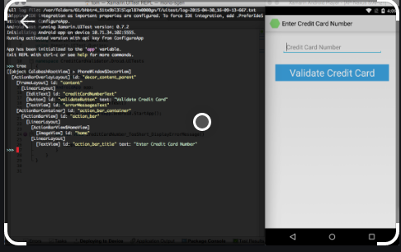

Slide 12
Clojure is a powerful, fun and highly productive language for developing applications and services. The clear language design is supported by a powerful development environment known as the REPL (read, evaluate, print, loop). The REPL gives you instant feedback on what your code does and enables you to test either a single expression or run the whole application (including tests).
Clojure uses repl based development
The REPL is the environment in which all Clojure code runs, whether that be during development, testing and production systems. As soon as I open a Clojure file I will start the REPL.
We can get fast feedback from my code as we design it, testing our assumptions and design choices.
As we are designing the code, we evaluate expressions and print the result under the expression as a comment. Adding results as comments is a great way to demonstrate the design of your code in a journal.

Slide 13
clojure.main :
The clojure.main namespace provides functions that allow Clojure programs and interactive sessions to be launched via Java’s application launcher tool java
clojure.main –help
runs an interactive Read-Eval-Print Loop
main options:
-r, --repl Run a repl ,path Run a script from a file or resource , - Run a script from standard input, -e, --eval string Evaluate expressions in string; print non-nil value
Most Clojure programmers, they use a REPL integration in their editor, which enables them to write expressions directly in their editor buffer and have them evaluated in the REPL with one hotkey.
Clojure.testlibrary is part of the Clojure standard library that provides a simple way to start writing unit tests.

